Slide 1
Object-Oriented Programming (OOP)
Week – 12
April 27-30, 2020
Instructor: Basit Ali
Email: basit.jasani@nu.edu.pk
Object-Oriented Programming (OOP)

Slide 2
Streams
Stream
A transfer of information in the form of a sequence of bytes
I/O Operations
Input: A stream that flows from an input device ( i.e.: keyboard, disk drive, network connection) to main memory
Output: A stream that flows from main memory to an output device ( i.e.: screen, printer, disk drive, network connection)

Slide 3
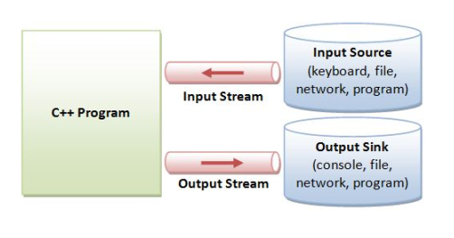

Slide 4
Iostream Library Header Files
iostream library
<iostream.h>: Contains cin & cout objects
<fstream.h>: Contains information important to user-controlled file processing operations

Slide 5
file (fstream)
ifstream - defines new input stream (normally associated with a file).
ofstream - defines new output stream (normally associated with a file).

Slide 6
General File I/O Steps
Include the header file fstream in the program.
Declare file stream variables.
Open the file
Use the file stream variables with >>, <<, or other input/output functions.
Close the file.

Slide 7
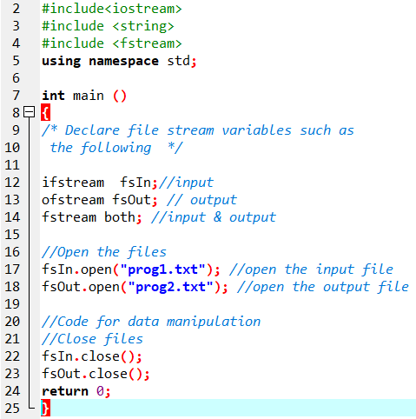

Slide 8
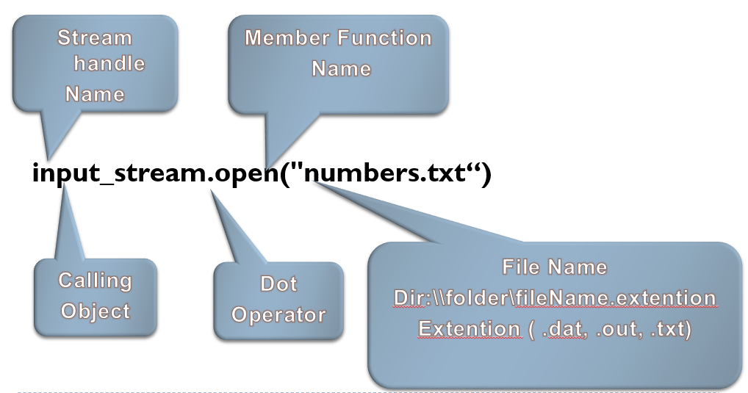
Object and Member Functions

Slide 9
Open()
Opening a file associates a file stream variable declared in the program with a physical file at the source, such as a disk.
In the case of an input file:
the file must exist before the open statement executes.
If the file does not exist, the open statement fails and the input stream enters the fail state
An output file does not have to exist before it is opened;
if the output file does not exist, the computer prepares an empty file for output.
If the designated output file already exists, by default, the old contents are erased when the file is opened.

Slide 10
Validate the file before trying to access
Method 1:
By checking the stream variable;
If ( ! Mystream)
{
Cout << “Cannot open file.\n ”;
}
Method 2:
By using bool is_open() function.
If ( ! Mystream.is_open()) {
Cout << “File is not open.\n ”;
}

Slide 11
Input File-Related Functions
fsin.get(char character)
extracts next character from the input stream fsin and places it in the character variable character.
fsin.eof()
tests for the end-of-file condition.

Slide 12
File I/O Example: Reading
Read char by char
Read a line
#include <iostream>
#include <fstream>
int main()
{//Declare and open a text file
ifstream openFile(“data.txt");
char ch;
//do until the end of file
while( ! OpenFile.eof() )
{
OpenFile.get(ch); // get one character
cout << ch; // display the character
}
OpenFile.close(); // close the file
return 0;
}
#include <iostream>
#include <fstream>
#include <string>
int main()
{//Declare and open a text file
ifstream openFile("data.txt");
string line;
while(!openFile.eof())
{//fetch line from data.txt and put it in a string
getline(openFile, line);
cout << line;
}
openFile.close(); // close the file
return 0; }

Slide 13
Output File-Related Functions
ofstream fsOut;
fsOut.open(const char[] fname)
connects stream fsOut to the external file fname.
fsOut.put(char character)
inserts character character to the output stream fsOut.
fsOut.eof()
tests for the end-of-file condition.

Slide 14
File I/O Example: Writing
First Method (use the constructor)
Second Method ( use Open function)
#include <fstream>
using namespace std;
int main()
{/* declare and automatically open the file*/
ofstream outFile("fout.txt");
//behave just like cout, put the word into the file
outFile << "Hello World!";
outFile.close();
return 0;
}
#include <fstream>
using namespace std;
int main()
{// declare output file variable
ofstream outFile;
// open an exist file fout.txt
outFile.open("fout.txt”);
//behave just like cout, put the word into the file
outFile << "Hello World!";
outFile.close();
return 0;
}

Slide 15
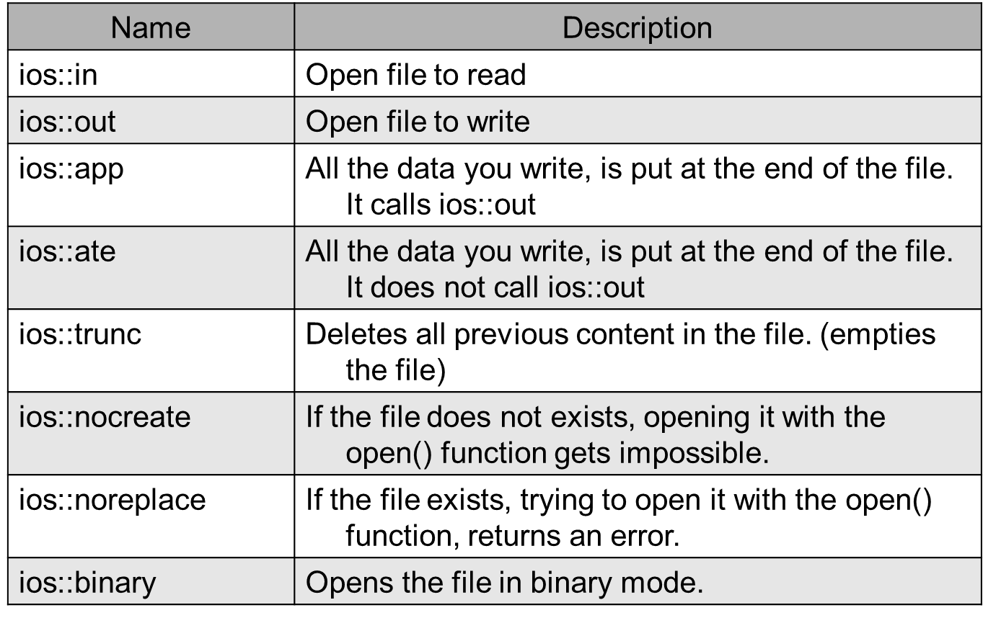
File Open Mode

Slide 16
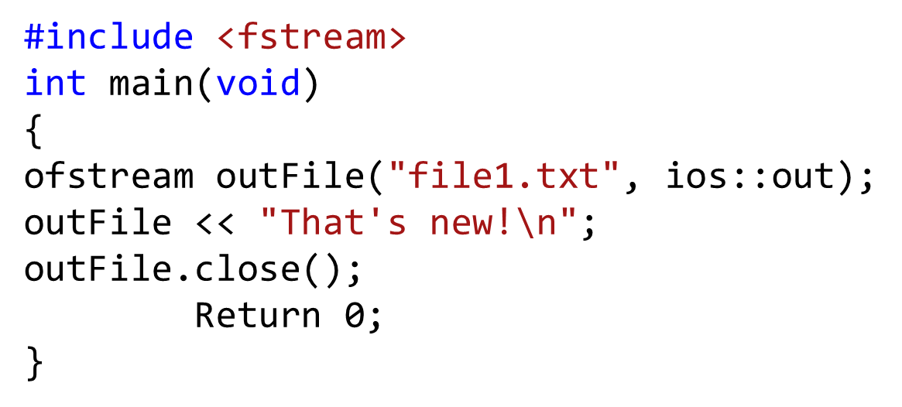
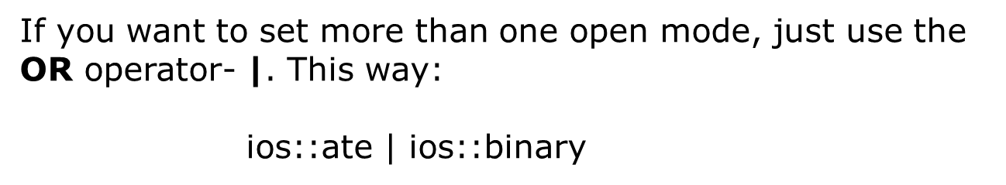
File Open Mode

Slide 17
File format
In c++ files we (read from/ write to) them as a stream of characters
What if I want to write or read numbers ?

Slide 18
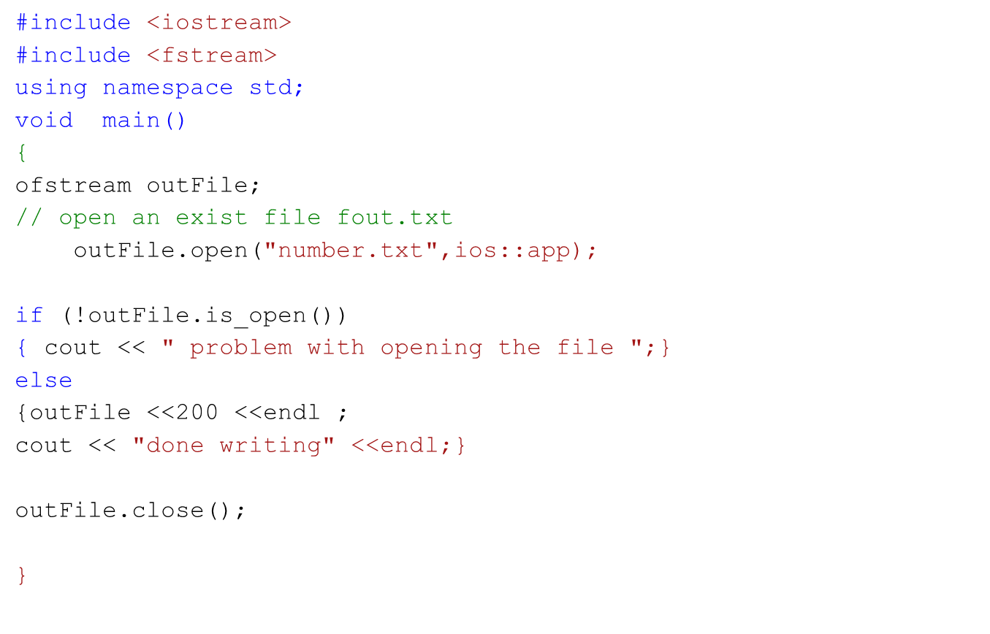
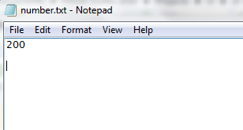
Example writing to file

Slide 19
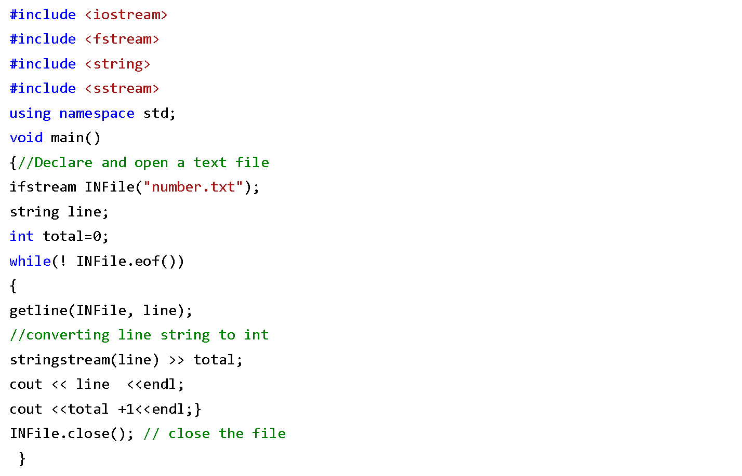
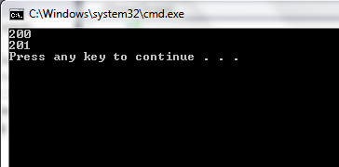
Example Reading from file

Slide 20
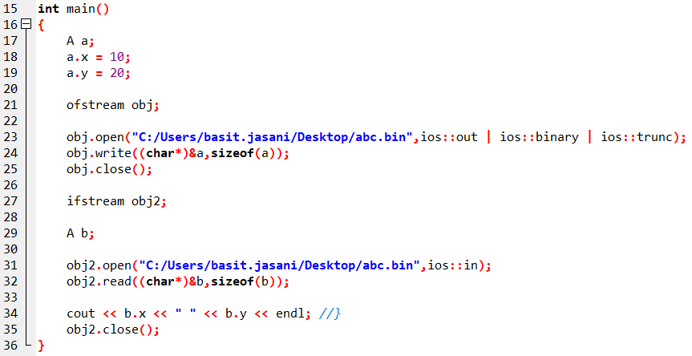
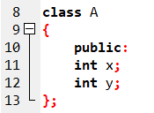
Writing OBJECTS to file

